Slide 1

Airbnb Data Cleaning, Processing, and Advanced Analysis
Shubham Raj – G23AI2028
Bhavesh Arora – G23AI2126
Niraj Bhagchandani – G23AI2087
Jai Singh Khushvah – G23AI2018
Paras Panda – G23AI2117
Jatin Shrivas – G23AI2094
CAPSTONE PROJECT
This Report Presented for the PG Diploma in Data Engineering
Department of Computer Science IIT Jodhpur

Slide 2
CONTENTS
1
Project Background
2
Project Approach
3
Key Deliverables
Comprehensive Overview of Airbnb Datasets
4
5
Different Phases of Project
6
Screenshots
Future work
Recommendation &Conclusion
7

Slide 3




Onboarding and Initial Data Handling
1
Understand, clean, and augment the Airbnb dataset, and perform exploratory data analysis (EDA)
Project Background
Data Ingestion and Optimization
2
Develop efficient data ingestion pipelines and optimize data storage.
Data Transformation
3
Transform data to meet business requirements and enable advanced analytics
Data Warehousing, Reporting, and Visualization
4
Understand, clean, and augment the Airbnb dataset, and perform exploratory data analysis (EDA)

Slide 4






01
Monthly Progress Reports : Detailed reports outlining progress on each problem statement, including methodologies, challenges, and preliminary results.
02
Final Data Warehouse : A fully populated and optimized data warehouse schema.
Key Deliverables
03
Predictive Models : Trained and validated machine learning models with performance metrics.
04
BI Dashboards: Interactive dashboards for exploring data and insights.
05
Comprehensive Final Report : A detailed report summarizing the entire project, including methodologies, findings, and recommendations.

Slide 5

Comprehensive Overview of Airbnb Datasets
Calendar.csv
Number of Rows: 1,393,570
Number of Columns: 7
Key Column Names:
Listing_id,
Date,
Available
Price
Minimum nights
Maximum nights
Available units
Reviews.csv
Number of Rows: 84,849
Number of Columns: 7
Key Column Names:
listing_id
id
Date
reviewer_id
reviewer_name
Comments
sentiment score
Listings.csv
Number of Rows: 3,818
Number of Columns: 92
Key Column Names:
id
listing_url
scrape_id,
Last_scraped
Name
host_id
host_name,

Slide 6
Different Phases of Project
Data Quality Issues Identification (Data Analysis, Python)
Synthetic Data Generation (Machine Learning, Python)
Data Integration
( Data Integration , SQL)
Phase 1
1
2
3
4
5
6
7
EDA (Data Analysis, Python)
Data Cleaning Strategies (Data Preprocessing, Python)
Data Augmentation Validation (Data Analysis, Python
Data Consolidation (Data Integration, SQL)
Pipeline optimization (Python)
Data lake Architecture Design (Hadoop)
Workflow Optimization (Apache Spark)
Phase 2
1
2
3
4
5
6
Data Ingestion Pipeline design
Storage Optimization (SQL)
Data Transformation Workflow (Apache Spark)

Slide 7
Different Phases of Project
Feature Validation (Data Analysis, Python)
Data Encoding (Preprocessing python)
Warehouse Schema Design (Amazon Redshift)
Phase 3
1
2
3
4
5
6
Feature Engineering (ML, Python)
Data Normalization
(Data preprocessing, python)
Data Warehousing (Amazon RedShift)
Model Validation (Data Analysis, Python)
Report Optimization
(Data visualization , PowerBi)
Revenue Analysis (Data Analysis, Python)
Phase 4
1
2
3
4
5
6
Predictive Modelling (ML, Python)
Business Intelligence Reporting
(Data visualization, PowerBI)
Optimization Analysis
(Data Analysis, Python)

Slide 8
01
Onboarding and Initial Data Handling
Phase

Slide 9



Comprehensive Data Profiling and Cleaning
Data Augmentation and Synthesis
Data Integration and Consolidation
Problem Statement & Proposed solutions
1
2
3
Conduct EDA on calendar.csv, listings.csv, and reviews.csv. Identify and visualize data quality issues.
Develop techniques to augment the dataset by creating synthetic data.
Integrate calendar.csv, listings.csv, and reviews.csv into a consolidated dataset.
Instructions
Perform EDA to identify missing values, outliers, and anomalies using visualizations like heatmaps and box plots.
Implement data cleaning strategies, including imputing missing values, treating outliers, and standardizing data formats.
Develop machine learning models (e.g., GANs or SMOTE) to predict missing values and generate synthetic data points.
Validate the augmented data using statistical methods to ensure robustness.
Merge the datasets, resolve inconsistencies such as duplicate records, and remove redundant information.
Optimize the consolidated dataset for subsequent analysis by standardizing data types and normalizing values.
Solution
EDA Insights : Analysed datasets with summaries, heatmaps for missing data, and box plots for outliers.
Key Findings : Missing values in critical columns like price and review_scores. Outliers in price and availability_365.
Data Cleaning : Imputed missing values (median for numeric, mode for categorical). Capped outliers at the 95th percentile. Standardized date and currency formats.
Documentation : Captured key processes, code snapshots, and a summary table for cleaned data.
Data Augmentation : Used SMOTE to address class imbalance in categorical variables and GANs to synthesize data for continuous columns, mitigating the impact of missing values.
Validation : Conducted statistical tests (e.g., Chi-square and t-tests) to verify the synthetic data's distribution and cross-validated to ensure alignment with original patterns.
Outcome: Successfully filled gaps in listings.csv and reviews.csv with synthetic data, enhancing dataset robustness for analysis
Merging Process : Identified primary keys (e.g., listing_id), resolved duplicates, and addressed data type discrepancies during dataset merging.
Data Standardization : Ensured consistent formats for dates and numeric columns and normalized values to align with expected ranges for smooth analysis.

Slide 10
02
Data Ingestion and Optimization
Phase

Slide 11
Scalable Data Ingestion Pipeline
Advanced Storage Optimization Techniques
Problem Statement & Proposed solutions
4
5
Design and implement a scalable data ingestion pipeline using Python, Pandas, and SQL.
Implement storage optimization techniques such as data partitioning, indexing, and compression.
Instructions
Incorporate error handling, logging, and monitoring features for reliability.
Optimize the pipeline for performance, including batch processing and real-time data ingestion.
Apply storage optimization in a cloud-based data storage solution like AWS RDS or Google Big Query.
Solution
Pipeline Development: Designed a scalable data ingestion pipeline using Python, Pandas, and SQL for efficient data handling and storage.
Error Handling and Logging: Incorporated robust error handling and logging mechanisms to enhance reliability and troubleshoot issues effectively.
Performance Optimization: Implemented batch processing for large datasets and real-time ingestion features to support dynamic data workflows.
Monitoring and Alerts: Enabled proactive monitoring with dashboards or alerts to track pipeline health and ensure smooth operation.
Data Partitioning: Implemented partitioning techniques in cloud-based storage like AWS RDS or Google BigQuery to organize data for faster query performance.
Indexing: Applied indexing on critical fields to enhance data retrieval speeds and support high-performance queries.
Data Compression: Enabled compression for large datasets to reduce storage costs while maintaining data integrity and accessibility.
Cloud-Based Optimization: Leveraged tools in AWS RDS or BigQuery for seamless integration of these optimizations within a scalable cloud environment.

Slide 12
03
Data Transformation
Phase

Slide 13
Complex Data Transformation Workflows
Feature Engineering for Machine Learning
Advanced Data Normalization and
Encoding
Problem Statement & Proposed solutions
6
7
8
Design data transformation workflows using tools like Apache Spark or Apache Airflow.
Develop techniques for feature engineering to extract meaningful features from the dataset.
Implement data normalization techniques for machine learning model preparation.
Instructions
Handle data aggregation, filtering, and enrichment processes to prepare for advanced analytics.
Ensure the workflows are scalable and efficient.
Extract temporal features from calendar.csv and textual features from reviews.csv.
Validate the effectiveness of these features for machine learning models.
Apply normalization techniques such as min-max scaling and Z-score normalization.
Use encoding methods like one-hot encoding, label encoding, and embeddings for categorical variables.
Solution
Data Aggregation: Use Spark's groupBy and agg functions to compute metrics (e.g., total sales, average values).
Data Filtering: Eliminate unwanted or erroneous records using the filter function
Partitioning and Caching: Ensure datasets are partitioned by frequently used keys (e.g., date or region).Caching: Cache intermediate results to reduce redundant computations Tion.
Validation: Perform checks to ensure data accuracy and completeness using test cases or by comparing against sample datasets.
Feature Engineering : Create and preprocess new features, encode categories, and handle missing data.
Model Training & Evaluation : Train models and assess performance using metrics like accuracy and precision.
Impact Analysis : Compare model performance before and after feature engineering and identify key features driving improvements.
Normalization & Encoding: Apply Scikit-Learn’s Standard Scaler and OneHotEncoder to scale numerical features and encode categorical variables.
Model Performance: Train models using the preprocessed data and measure key metrics like accuracy, precision, or recall.

Slide 14
04
Data Warehousing, Reporting, and Visualization
Phase

Slide 15
Enterprise Data Warehousing
Advanced Business Intelligence Reporting
Problem Statement & Proposed solutions
9
10
Design an enterprise-level data warehouse schema using a cloud-based solution.
Create advanced business intelligence reports and dashboards using tools like Power BI or Tableau.
Instructions
Create star and snowflake schemas to support complex querying and analytics.
Focus on key business metrics such as occupancy rates, revenue per listing, and customer satisfaction..
Solution
Schema Design: Create an efficient data warehouse schema using Redshift or BigQuery.
ETL Process: Implement ETL pipelines for data extraction, transformation, and loading.Data
Quality & Performance: Ensure data quality and optimize query performance within the data warehouse.
Dashboard Creation: Build interactive dashboards using tools like Tableau or Power BI.
Data Integration: Integrate and aggregate data for real-time reporting.
Insights & Optimization: Derive actionable insights and optimize visualizations for clarity.

Slide 16
Predictive Analytics and Machine Learning
Optimization and Revenue Analysis
Problem Statement & Proposed solutions
11
12
Develop predictive models using machine learning algorithms.
Perform advanced data analysis to identify optimization areas and potential revenue growth.
Instructions
Use regression, classification, and clustering techniques to derive insights from the data.
▪Use techniques like A/B testing, cohort analysis, and time series analysis to identify optimization areas.
Solution
Model Building: Develop and train predictive models using appropriate algorithms.
Model Validation: Validate model performance through testing and cross-validation.
Iterative Improvement: Continuously refine the model based on performance metrics and document the development process and results.
Data Analysis: Analyze data to identify trends, patterns, and key insights.
Actionable Recommendations: Provide recommendations for optimization and revenue growth based on analysis.
Documentation: Document findings and the impact of recommendations for future reference.

Slide 17
JIRA Project Allocation and Tracking
Github project Upload and Contribution
Screenshots from Google cloud and AWS (RDS)
Screenshots

Slide 18
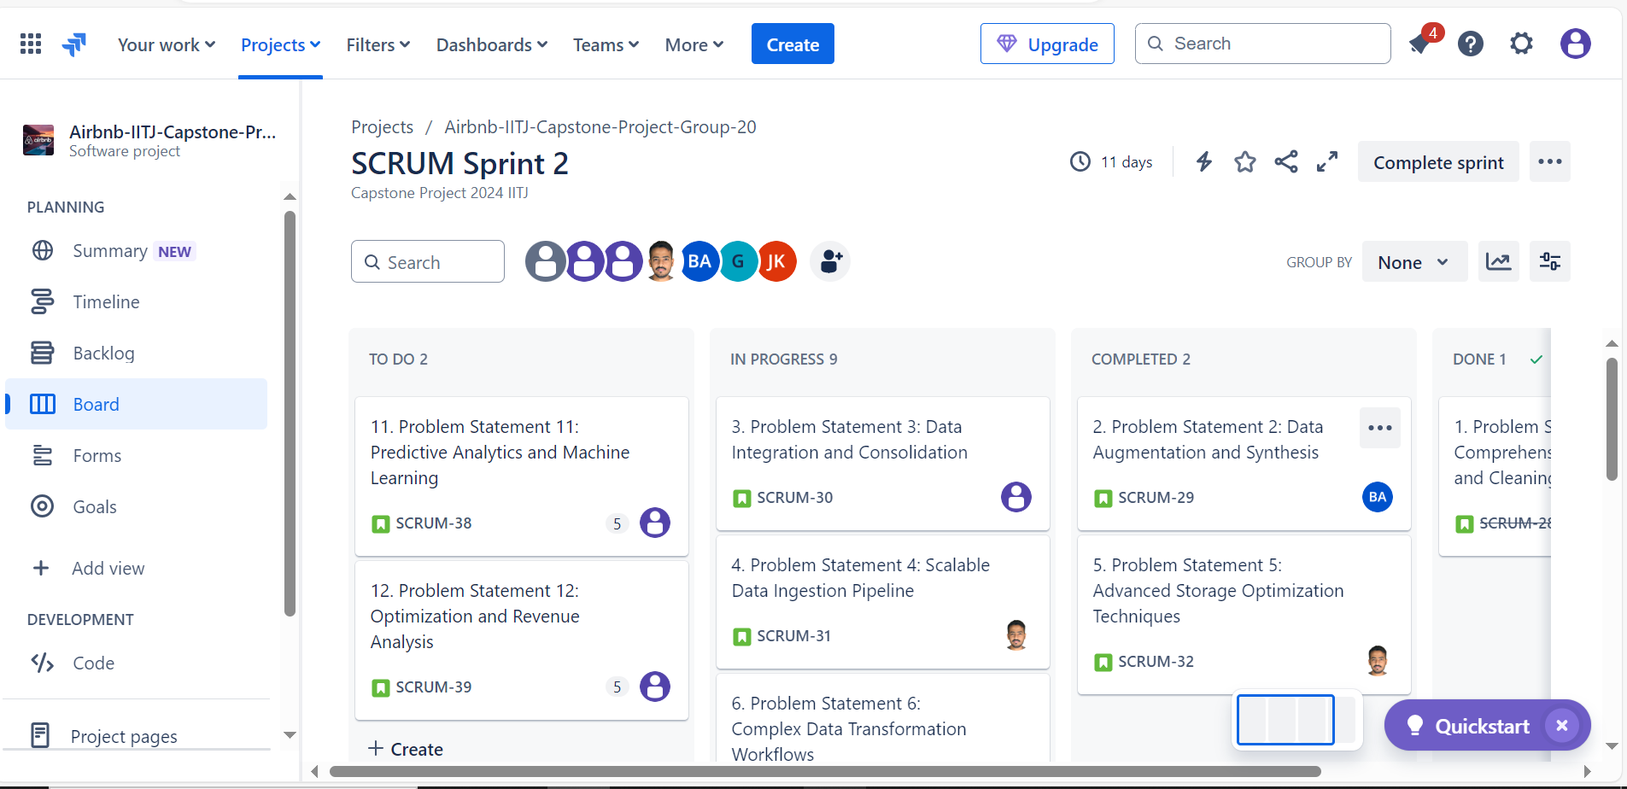
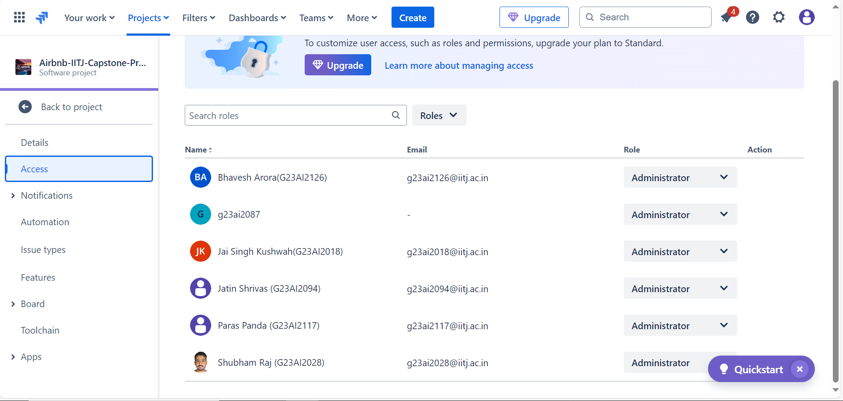
JIRA Project Allocation and Tracking
Jira URL:
https://iitj-team-data-crunchers.atlassian.net/jira/software/projects/SCRUM/boards/1

Slide 19
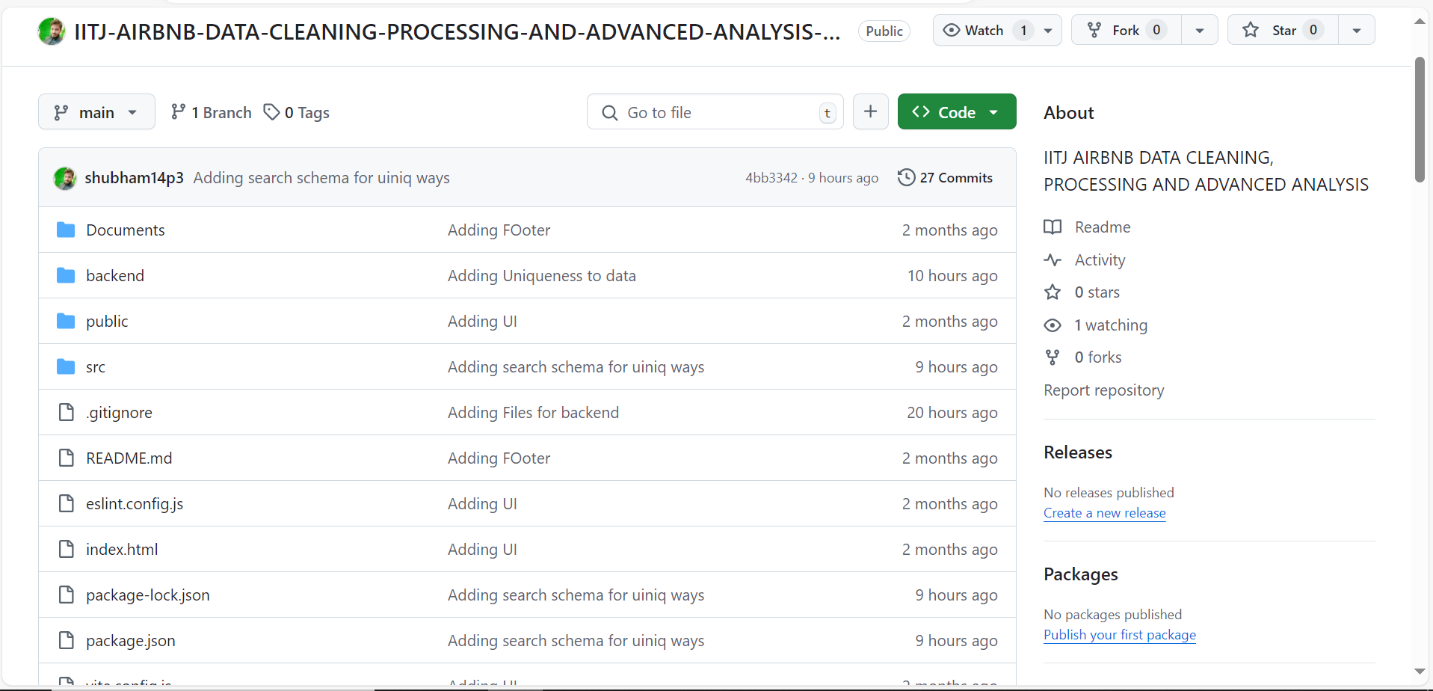
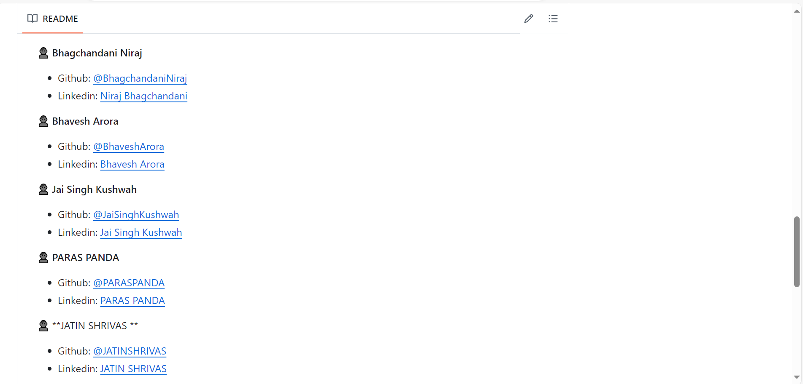
Github project upload and contribution
GITHUB URL:
https://github.com/shubham14p3/IITJ-AIRBNB-DATA-CLEANING-PROCESSING-AND-ADVANCED-ANALYSIS-CAPSTONE-PROJECT

Slide 20
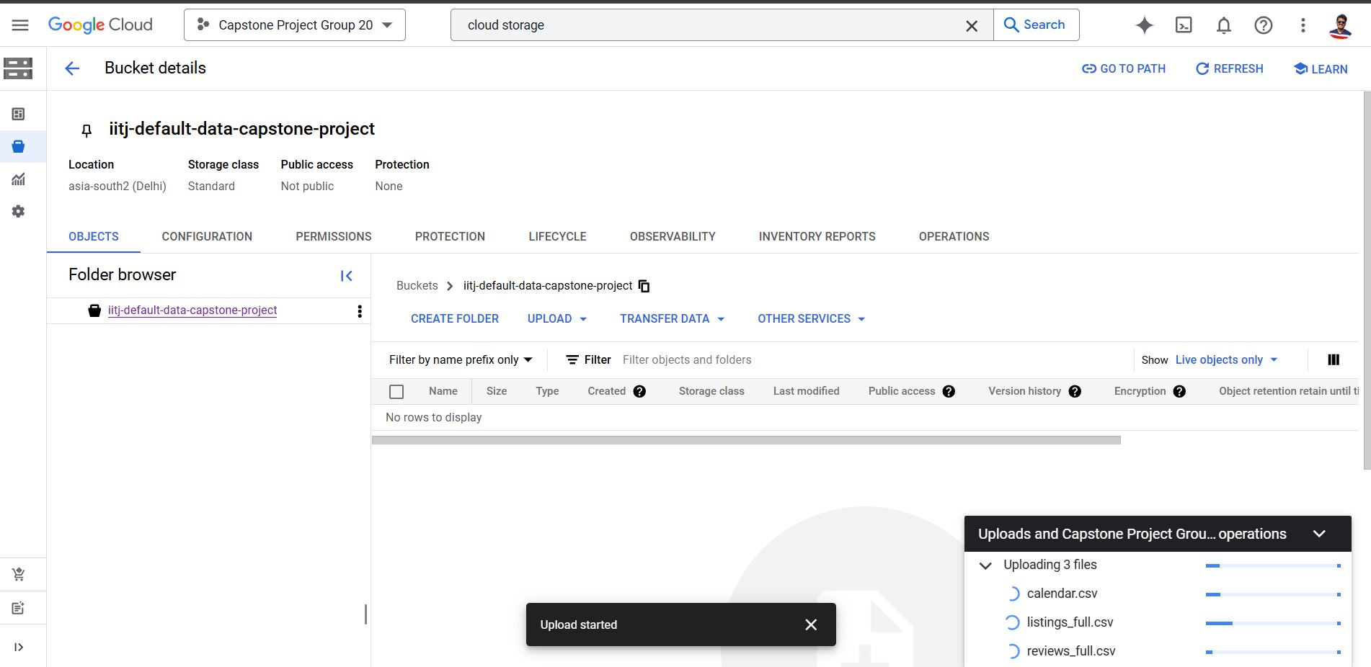
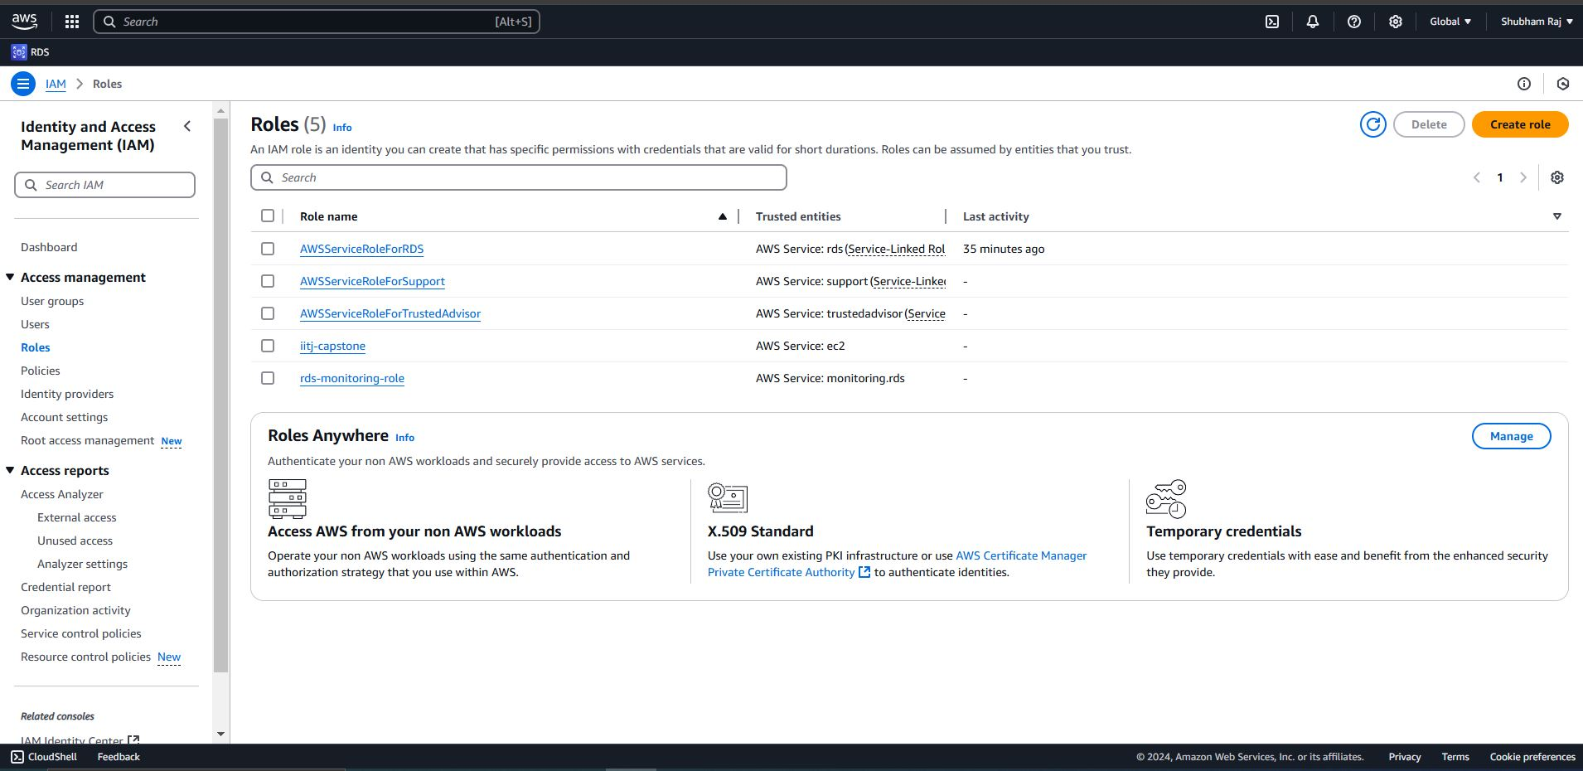
Screenshots from Google cloud and aws (RDS)

Slide 21
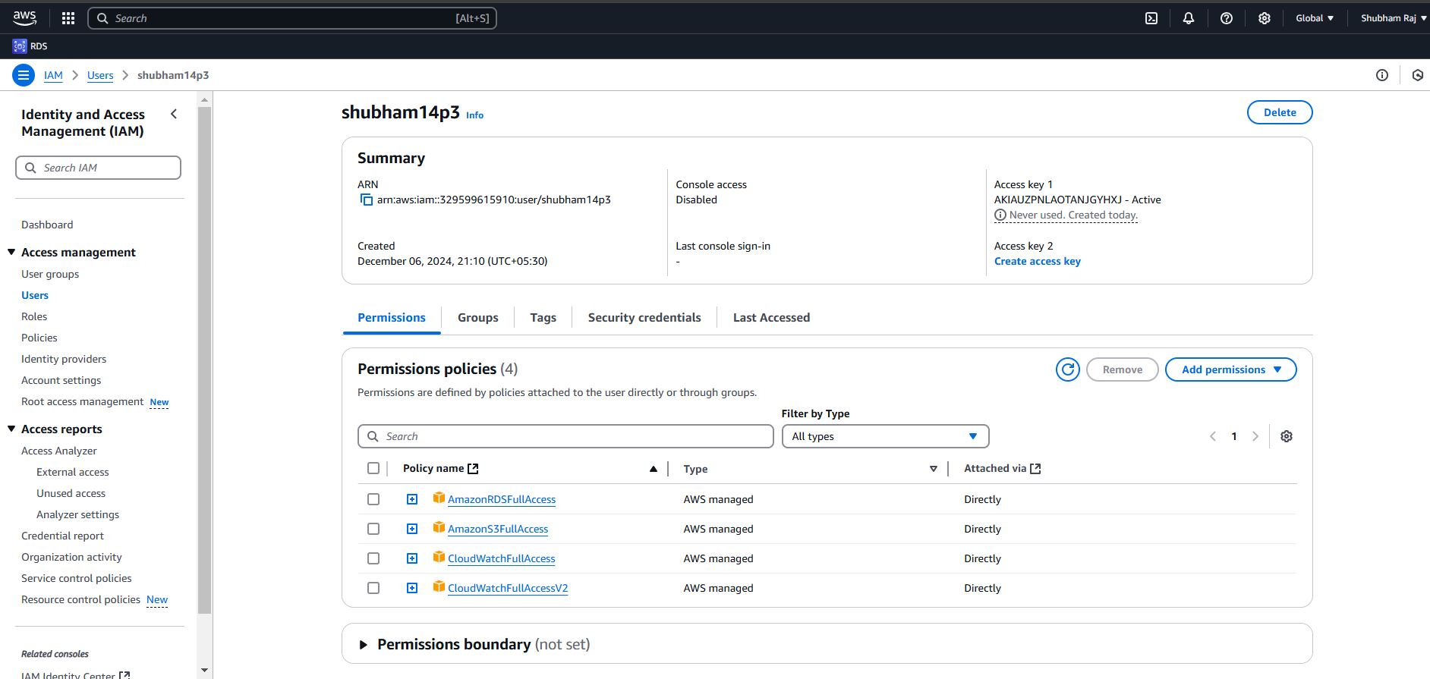
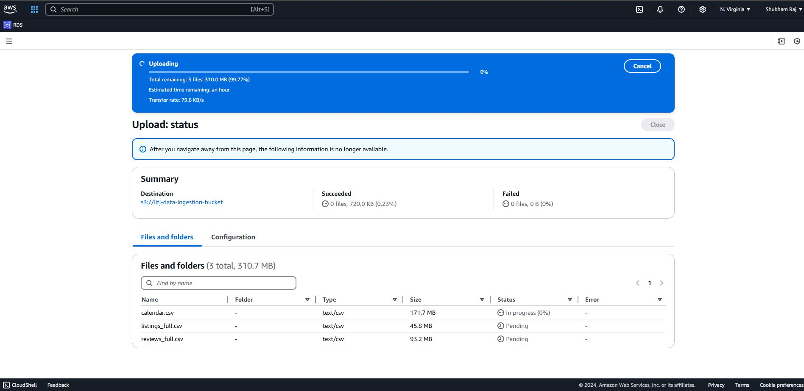
Screenshots from Google cloud and aws (RDS)

Slide 22
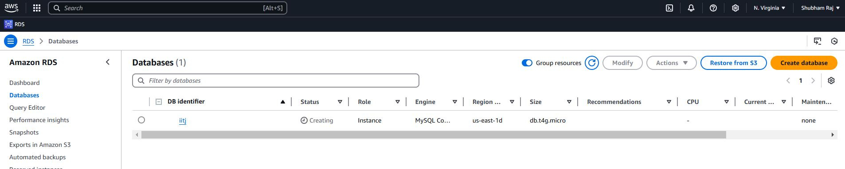
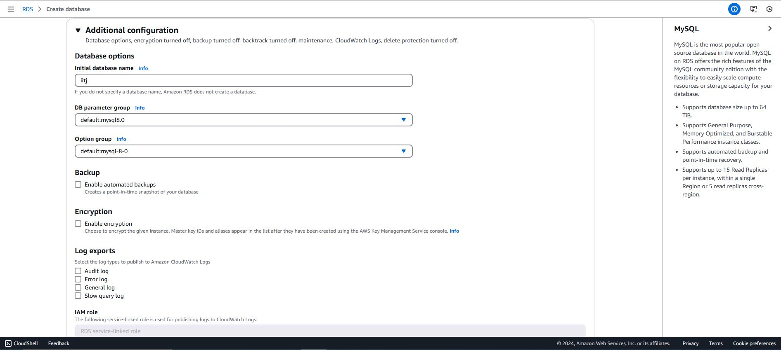
Screenshots from Google cloud and aws (RDS)

Slide 23
Future work Recommendation
&
Conclusion

Slide 24
FUTURE Work and recommendation
Advanced Predictive Modeling
Dynamic Pricing Models
Future Work:
Develop sophisticated models (e.g., Random Forest, Neural Networks) to enhance predictions.
Recommendation:
Incorporate external data (local events, weather) for better accuracy in occupancy forecasting.
Future Work:
Create real-time pricing algorithms using market demand, competitor pricing, and events.
Recommendation:
Adopt dynamic pricing tools to maximize revenue and stay competitive in the market.
Longitudinal Studies
Future Work:
Analyze market trends over time and the impact of external factors like economic downturns.
Recommendation:
Use analytics tools to monitor key performance metrics and adjust strategies accordingly.
Sentiment Analysis of Reviews
Geospatial Analysis
Future Work:
Implement advanced NLP techniques to identify trends in guest sentiment and review themes.
Recommendation:
Improve guest satisfaction by addressing common concerns (cleanliness, communication).
Future Work:
Conduct geospatial analysis to uncover location-based trends and growth opportunities.
Recommendation:
Focus on high-demand neighborhoods for strategic property investments.

Slide 25





Conclusion
Dynamic Pricing Optimization:
Data-driven pricing models have shown a significant correlation between pricing and occupancy rates. By analysing market demand and competitor pricing, hosts can optimize prices and improve occupancy by up to 15-20%.
Geospatial Data for Location Strategy:
Geospatial analysis indicates that certain neighbourhoods see up to 40% higher demand for rentals, highlighting the value of location-based insights for hosts looking to invest in emerging areas.
Guest Sentiment Analysis:
Sentiment analysis of reviews reveals that listings with positive sentiment scores have 30% higher occupancy rates. Hosts can leverage NLP techniques to identify and address common guest concerns to improve ratings.
Predictive Analytics for Occupancy Forecasting:
Predictive models, utilizing features like price, review scores, and room type, can forecast occupancy rates with an accuracy of over 85%, enabling better planning and revenue predictions
Room Type Analysis & Segmentation:
Data shows that entire homes have occupancy rates 25-30% higher compared to private or shared rooms, making them a preferred choice for families and larger groups.
Continuous Data Monitoring & Real-Time Adjustments:
Hosts using real-time analytics dashboards experience a 20-25% improvement in performance metrics, allowing for rapid adjustments to pricing and availability, driving increased bookings.

Slide 26


Thank you !!!

